Slide 1
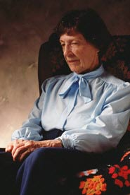
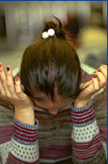
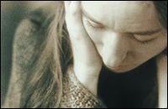
Mental Disorders
Mr. Beerbower
Health Education

Slide 2
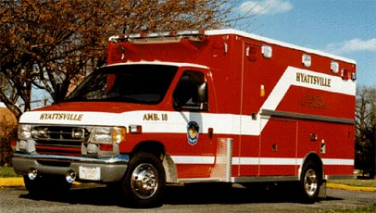
Organic Disorders
Caused by a Physical Illness or injury that affects the brain.
Examples
Brain Tumors
Strokes
Infections
Drug use
Exposure to poison
Source: Glencoe Health 2007

Slide 3
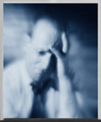
Functional Disorders
Caused by Psychological Issues. Cannot be traced to physical causes.
Examples
Stress
Emotional Conflict
Poor Coping Skills
Source: Glencoe Health 2007

Slide 4
Kinds of Mental Disorders
Functional Disorders that will be covered:
Anxiety Disorders
Affective Disorders
Personality Disorders

Slide 5
Anxiety Disorders
Anxiety Disorders: Are real or imagined fears that prevent a person from leading a normal life.
About 4 Million Americans suffer from various anxiety disorders
Examples that will be discussed
Phobias
Obsessive-Compulsive Disorders
Panic Disorders
Post-Traumatic Stress Disorders

Slide 6
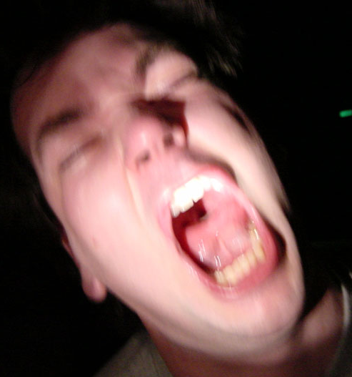
Phobias
Phobia: When a person has an extreme or exaggerated fear of something and will go to extreme measures to avoid it.
Treatment options;
Confrontation of the fear
Therapy

Slide 7
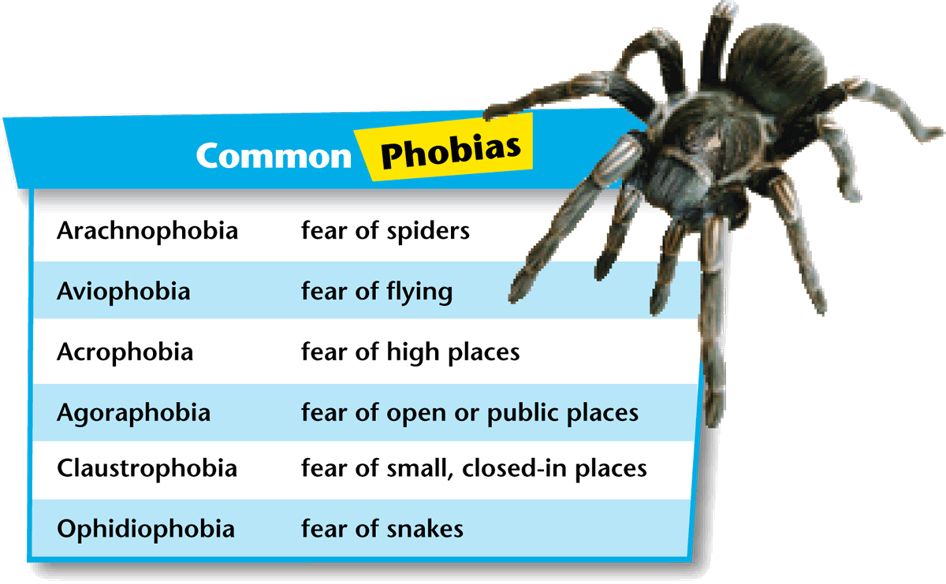

Slide 8
Can You Guess the Phobia??
Agoraphobia
Alektrophobia
Altophobia
Androphobia
Arachibutyrophia
Bogeyphobia
Coulorphobia
Dentophobia
Didaskaleionophobia
Glossophobia
Helminthrophobia
Ippopotomonstrosesquippedaliophobia
Necrophobia
Paraskavedekatriaphobia
Triskaidekaphobia
Urophobia
Venustraphobia
Zoophobia

Slide 9
Phobia Answers
Agoraphobia: Fear of leaving a safe place
Alektrophobia: Fear of chickens
Altophobia:Fear of heights
Androphobia: Fear of men
Arachibutyrophia: Fear of Peanut butter sticking to the roof of your mouth
Bogeyphobia: Fear of bogeyman
Coulorphobia: Fear of clowns
Dentophobia: Fear of dentists
Didaskaleionophobia: Fear of going to school
Glossophobia: Fear of public speaking

Slide 10
Phobia Answers Continued
Helminthrophobia: Fear of being infested with worms
Ippopotomonstrosesquippedaliophobia: Fear of long words
Necrophobia: Fear of dead things
Paraskavedekatriaphobia: Fear of Friday 13th
Triskaidekaphobia: Fear of the number 13
Urophobia: Fear of urine
Venustraphobia: Fear of beautiful women
Zoophobia: Fear of animals

Slide 11
Obsessive-Compulsive Disorders
Obsessive-Compulsive Disorders (OCD)
Are persistent and repeated behaviors or thoughts that may get in way of daily activity.
Obsession: an unwanted thought that takes control of the mind
Compulsion: an unreasonable need to behave in a certain way to prevent a feared outcome
Treatments:
Luvox or Paxil (medicine) &/or Therapy

Slide 12
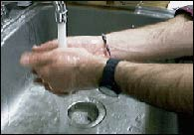
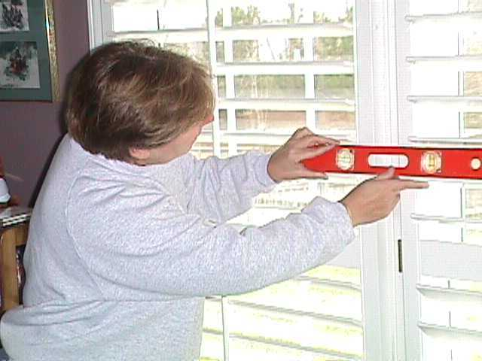
OCD Symptoms
May wash hands repeatedly
Ritual Behaviors
Must have order

Slide 13
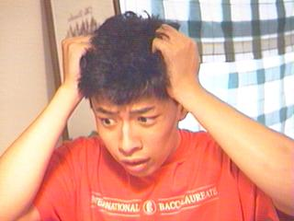
Panic Disorders
Example: Panic Attacks!!
Are characterized by a person feeling anxious, fearful, and possibly upset most of the time, but for no specific reason. These individuals may suffer from Panic Attacks!
Treatments
Behavioral Therapy and/or Medication
Example: Brianna was standing in line at the movies. Suddenly, for no apparent reason, she felt intense fear and a strong desire to leave the theater. Brianna was having a panic attack.
People who have repeated panic attacks tend to worry about having another. To avoid the attack, they may change the behavior.
Ex: they happened in restaurants, they stop going out to eat.

Slide 14
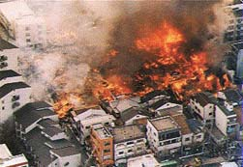
Post-Traumatic Stress Disorder
Usually a result of a traumatic event that leaves individuals with long-lasting effects for as little as a few weeks or years after the event.
Example Causes:
Victim of a violent crime
Rape
Military Service
Natural Disasters (fire, earthquake)
Disasters (9-11)
Treatment: Therapy / Behavioral Therapy &/or medication (anti-depressants)

Slide 15
Affective Disorders
These are usually called “Mood Disorders”. People suffering from them may have feeling of great happiness (followed by extreme sadness) or just great sadness
Examples:
Clinical Depression
Manic-Depressive Disorder or Bi-Polar
Seasonal Affective Disorder

Slide 16
Clinical Depression
When a person has a feeling of sadness for more than a period of a few weeks. Can be brought on by an event, such as divorce, but lasts much longer than “normal”. They are unable to handle life’s daily tasks such as school or work, basic decision making, or even sleep
Approximately 19 million Americans are affected by depression each year (Glencoe Health 2007)
More than 1 in 20 Americans ages 12 or older have some form of depression (CDC 2005-06)
Depression often runs in families and can be biologically based, but it can also be caused by life event. Sometimes it may be a symptom of substance abuse or addiction, because alcohol and other drugs can affect brain chemistry.
Treatment: Medications (Zoloft, Paxil, Luvox, Wellbutrin)

Slide 17
Mental
4 or more, everyday for 2 weeks straight
Difficulty concentrating
Persistent negative thoughts
Physical
A major change in eating and/or sleeping patterns
Overeating/not eating enough
Fatigue
Unusual aches and pains
Excessive alcohol/drug use
Emotional
Prolonged sadness
Irritability or anger
Low self esteem and guilt
Persistent boredom, low energy
Decreased interest in activities or inability to enjoy activities
Thoughts or expressions of suicide or self destructive behavior

Slide 19
Manic-Depression Disorder or Bi-Polar Disorder
Patients suffer from extreme feelings of happiness or sadness for no apparent reason. Between these episodes of extreme happiness and sadness, they may act normal. This is often inherited and symptoms can be helped with medication. (usually Lithium is used as a treatment… but can be very dangerous if too much in system)
Thyroid problems
Reduces mood swings
Can be toxic / kidney failure

Slide 20
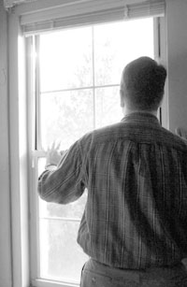
Seasonal Affective Disorder (S.A.D.)
Effect many people who seem to be happy in the summer, but “SAD” in the winter.
The reason is because the earth’s dark/light cycle influences the hormone melatonin
Treatment:
Light Boxes – Usually ½ hour each day. (these bright florescent lights will work for about 80% of patients)

Slide 21
Personality Disorders
Personality Disorders: Include a variety of psychological conditions that affect a person’s ability to get along with others.
Examples
Anti-Social Personality Disorders
Schizophrenia
Multiple Personality Disorder or (Dissociative Identity Disorder)

Slide 22
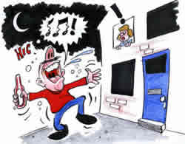
Anti-Social Personality Disorder & Conflict Disorders
Characterized by a person’s constant conflict with society. These individuals often display behavior that is cruel, uncaring, irresponsible, impulsive, and inappropriate to society.

Slide 23
Schizophrenia
Schizophrenia means “split mind”.
It is usually diagnosed between the ages of 15-35.
Estimated that 1% of the population (1 in 100 people, 2.5 million) with some type
Treatments: 50% with this disorder are unable to understand that they are ill. 60% can have symptoms treated. 40% cannot have symptoms treated. Side effects of some of the drugs are hard to deal with. Antipsychotic meds and counseling work best.

Slide 24
Possible Different Schizophrenia Behaviors
Paranoid
Believe that others are out to get them.
Disorganized
Random thoughts / odd speech pattern
Inappropriate or abnormal emotional responses
Catatonic
Withdrawn, mute, often assumes very unusual body positions for long periods of time
Residual
No more symptoms or hallucinations
But no longer have any interest in life.

Slide 25
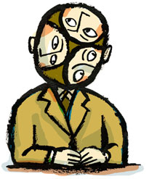
Dissociate Identity Disorder OR Multiple Personality Disorder
Definition: Can be characterized by a person having 2 or more distinctly different personalities & identities
It may develop because of mental, physical, or sexual abuse
Problems with this disorder?
Some doctors don’t believe in it
People may abuse diagnosis
Often confused it with schizophrenia – but not related

Slide 26
Other Mental Health Topics
Tricholtillomania
Means “hair pulling frenzy”
3% of population (90% are females… are 5 times more likely)
Usually very ashamed….try to hide it . Usually beginning in teen years
Common with OCD
Munchausen Syndrome by Proxy
The intentional harming of oneself or others in order to draw sympathy or attention to themselves.
95% of cases are mothers harming children
ADHD (Attention Deficit Hyperactivity Disorder)
3-5% of population (9 : 1 ratio males to females)
Difficulty maintaining attention, controlling impulsiveness, usually inappropriate.
Medications may help if they have ADHD
Studies have shown a dramatic increase in the number of diagnosed cases and has caused controversy over their authenticity.

Slide 27
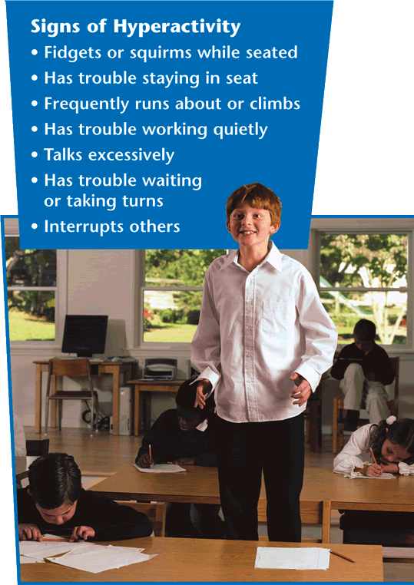

Slide 28
Other Mental Health Topics
Alzheimer’s Disease
Impaired memory / confusion
11% of elderly ages 65 & up, 20% of elderly ages 75 & up.
Actual loss of brain matter
Pedophilia
Individuals who engage in sexual activity with child (generally ages 13yrs & under)
95% are males with no gender preference
No specific treatment, But Castration (removal of testicles) used to be used
Tourette’s Syndrome
Characterized by uncontrollable “tics” (movements or sounds)
meds may help control – but not 100%
Only 10% have obscenity tics

Slide 29
Other Mental Health Topics Cont..
Tourette’s Syndrome
Characterized by uncontrollable “tics” (movements or sounds)
meds may help control – but not 100%
Only 10% have obscenity tics
Hypochondria: A somatoform disorder characterized by constant fear of disease and preoccupation with one’s health
A person could fake symptoms out of a medical book. He/she could then produce the symptoms within a few days. He/she will visit different doctors until diagnosed
Somatoform Disorders: A mental disorder in which a person complains of physical symptoms, such as pain, when no underlying physical causes can be found.
Impulse-Control Disorders
Cannot resist the impulse, or drive, to act in a way that is harmful to themselves or others.
Ex: uncontrolled shopping (85% female), uncontrolled gambling (75 million people in the U.S. cannot control the urge to gamble), impulse to steal (Kleptomania)

Slide 30
Autism
Autism – A disorder of childhood, characterized by marked deficits in communication and social interaction, pre-occupation with fantasy, language impairment, and abnormal behavior, such as repetitive acts and excessive attachment to certain objects.

Slide 31
Types of Mental Health Professionals
Psychiatrist – A physician (medical doctor) who can diagnose and treat mental disorders. (can prescribe meds)
Psychologist – specializes in mental disorders but CANNOT prescribe medications
Clinical Psychologists – trained to recognize and treat behavior that is not normal. They have a doctoral degree in psychology and practical training experience in clinics & hospitals.
Social Worker – work as a link between people who need help and community resources that provide help
Neurology – medical science that deals with the nervous system and disorders affecting it
Neurologists: A physician who treats physical disorders of the nervous system.

Slide 32
The End!

